Slide 1
Auto-Diagnosis System
Ting-Hsuan Chung, Zihan Zhao, and Jiaying Zheng
Advisor: Dr. Fatema Nafa
DS 5500 Capstone Project Presentation

Slide 2
Outline
3
Student Objectives
4
Problem Specification
5
Related Work
6
Amendments
7
Solution Design
8-11
Methodology
12
Tools List
13
Time Schedule
14-17
Demo Videos
18-20
Result
21
Postmortem
22
Deliverable
23
Contribution
24
Reference
26
Q&A

Slide 3


Student Objectives
Purpose:
Enhancing the accuracy and efficiency of pathology diagnosis and differential diagnostics.
Learning Outcomes:
Gain Experience in Complex Data Preprocessing
Boost understanding of Machine Learning models including LSTM, Transformer.
Familiarize Python libraries: Tensorflow, Pytorch
Learning how to use version control tools: Github and Overleaf

Slide 4
Problem Specification
Introduction to the Problem: We aim to use the patient data to predict patients’ pathology or to generate differential diagnosis. Our group planned to apply different models to find more effective ML models for pathology and differential diagnosis prediction. We also plan to apply our own inquiry system on the best performed model to imitate the real world experience.
Scope of the Problem: Model comparison in auto diagnosis system.
Impact of the Problem: Accurate medical diagnosis is critical for patient treatment and recovery, and manual diagnostic processes are often time-consuming and subject to subjective bias. By harnessing the power of ML, diagnostic processes within the healthcare system can be improved.
Challenges and Constraints: Previous models have struggled with insufficient accuracies when generating differential diagnosis.

Slide 5
Related Work
A
DDXPlus: A new dataset for automatic medical diagnosis(Fansi Tchango et al., 2022) presented an innovatively created large dataset that incorporate differential diagnosis, pathology and multi choice of symptoms and antecedents. We used this dataset as the main data source of the project.
B
Efficient symptom inquiring and diagnosis via adaptive alignment of reinforcement learning and classification(Yuan & Yu, 2024) used reinforcement learning for information inquiry and classification techniques for disease diagnosis. It’s one of the models we would like to compare.
C
Knowledge grounded conversational symptom detection with graph memory networks(Luo et al., 2021) propose a novel goal-oriented dialog task, automatic symptom detection. The method was adapted to build one of the models in the paper, which we would also like to compare.
D
DDxT: Deep generative transformer models for differential diagnosis(Alam et al., 2023) proposed the transformer model to the same dataset and reached higher metrics, but the inquiry system was not included in the model. It’s one of the models we would like to compare.

Slide 6
Amendments
RNN Random Forest
LSTM: Traditional RNN will gradient vanish when apply multi layers.
Neural Network: RF is time consuming while predicting multi-category outcomes with extremely large dataset.

Slide 7
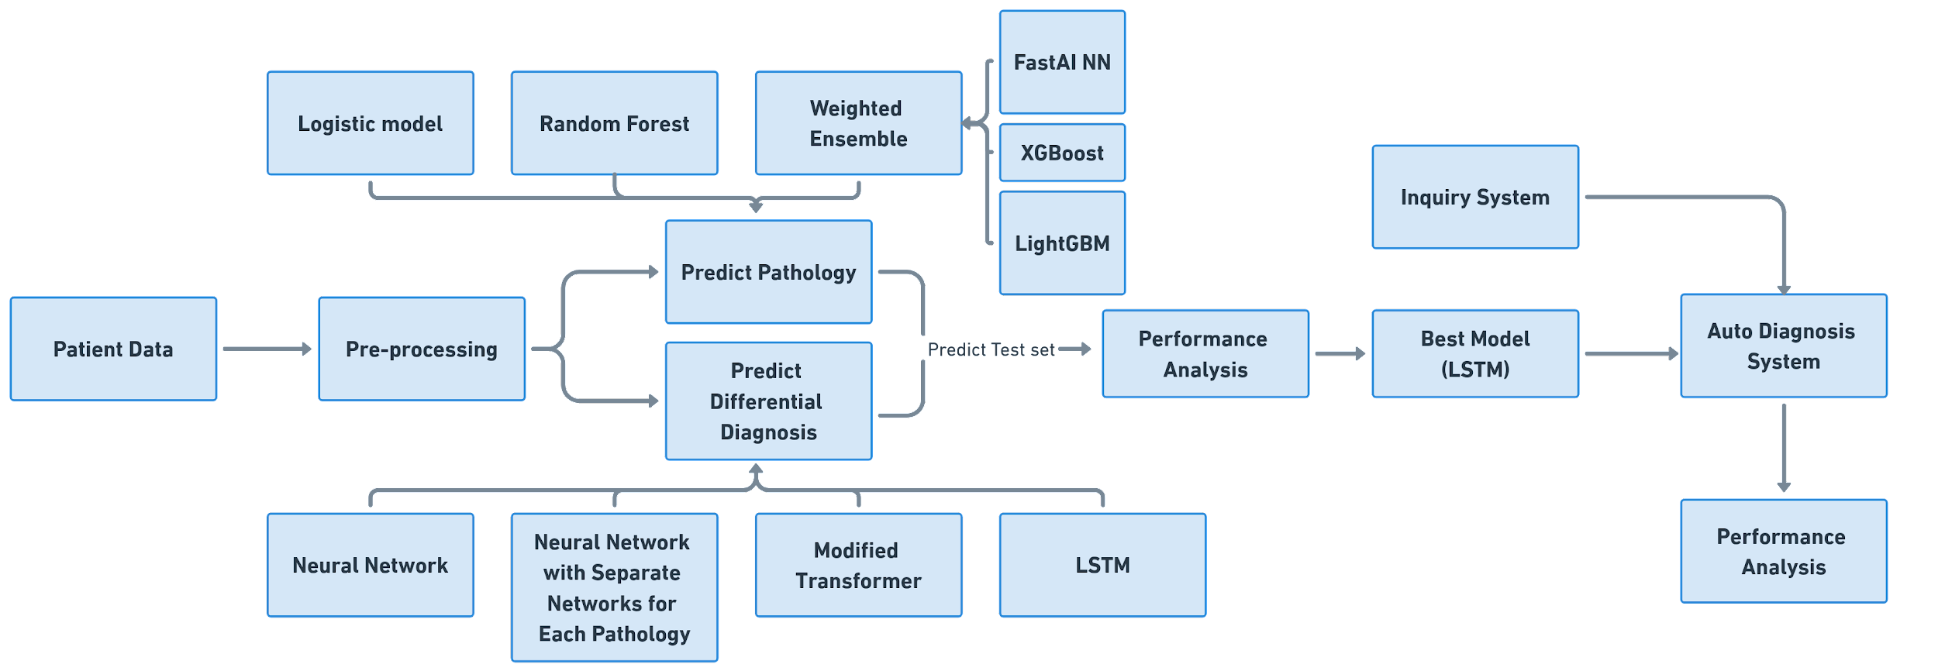
Solution Design
Notes:
After preprocessing the patient datasets, we implement Logistic Regression, Random Forest, and Weighted Ensemble algorithms into the training datasets to predict pathology and also implement Neural Network, Neural Network with Separate Networks for Each Pathology, Modified Transformer, and LSTM into training datasets to predict differential diagnosis. Then we applied each model into test datasets to analysis the model performance. We choose the best performance model which is LSTM model here to implement with a simple inquiry system to build our auto diagnosis system and analysis the system performance.

Slide 8
Methodology
Differential DIagnosis
Auto-Diagnosis System
Preprocessing
Pathology
Data Reading
Typo Checking
One-Hot Encoding
Logistic Regression Random Forest
Weighted Ensemble
Neural Network
Neural Network w/Separate Network for each Pathology
Modified Transformer
Long Short-Term Memory Model
Implement LSTM Model into an Inquiry System

Slide 9
Methodology - Pathology
Logistic Regression
Simplicity for vast datasets.
Computational efficiency, and the interpretable nature of results.
Random Forest
Proficient in managing large datasets
Inherent mechanisms to prevent overfitting
Weighted Ensemble
Leverage the diverse perspectives of models to make more informed predictions
Ensemble model of Neural Networks, LightGBM, and XGBoost.
Notes:
Logistic Regression: Since we want to build a classification model for pathology prediction, the first machine learning algorithm came into our mind was logistic regression algorithm. Our dataset is very large and the simplicity of dealing with vast datasets of logistic regression is a great fit. Also, the computational efficiency, and the interpretable nature of the results of logistic regression fulfill our requirement.
We combine 3 model,Neural Networks, LightGBM, and XGBoost, in our ensemble model

Slide 10
Methodology - Differential Diagnosis
Neural Network
Catch complex non-linear relationship
Automatically learn feature, less time consuming
Good scalability while processing large dataset
Very flexible, can optimized by adjusting layers
Neural Network with Separate Network for each Pathology
Train each pathology in differential diagnosis as a classification problem
Previous predicted pathologies are also inputs to classify the next
Generate differential diagnosis by predicting each pathology in sequence
Modified Transformer
Disabled the positional embedding in the encoder since the sequence in the input evidence is not related to the differential diagnosis
Long Short-Term Memory Model (LSTM)
Overcome the gradient vanishing problem of traditional RNNs.
Effective learning from sequential data.
The long-term dependency learning structure can improve prediction accuracy in binary diagnosis task.
Notes:
LSTM: Like Zihan mentioned before, traditional RNN is easy to gradient vanish for multiple layers. LSTM can overcome this gradient vanishing problem. Also, LSTM has the effective learning ability from sequential data, like our datasets. Finally, the long-term dependency learning structure of LSTM can improve prediction accuracy in binary diagnosis task.

Slide 11
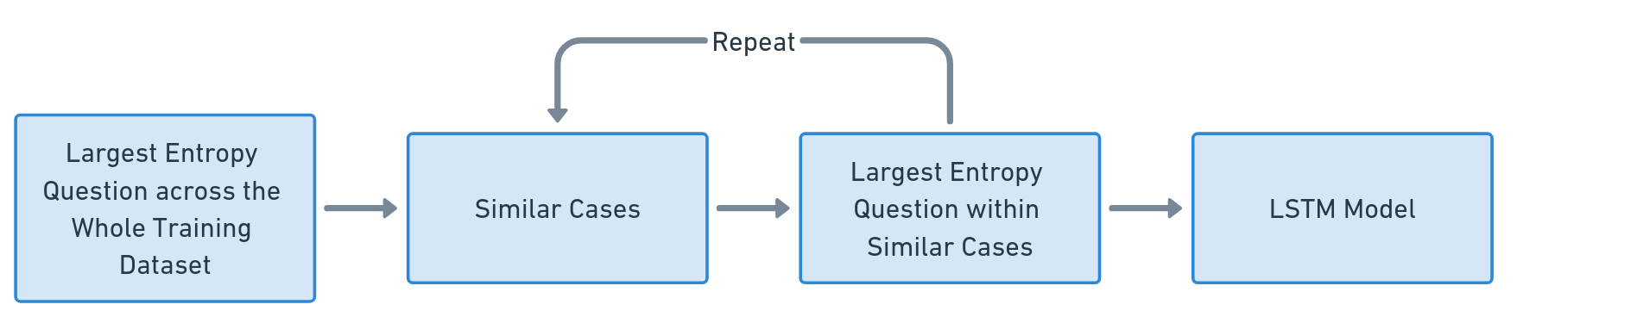
Methodology -
Incorporating The Inquiry System
Notes:
Here is how our simple inquiry system works.
First, it finds the question that has the largest entropy across the whole training dataset and makes it as the first question.
According to the patient's answer, it finds the similar cases by applying Manhattan distance to all the cases in the training dataset.
Within similar cases, it finds the question that has the largest entropy and makes it as the next question.
Repeat to find similar cases by combining all previous answers and calculate entropies again until the question length reaches the setting.
Finally, we send the data gathering from the user to the LSTM model to generate differential diagnosis.

Slide 12
Tools List
Python >= 3.8
A
Libraries: Pandas; Numpy; Matplotlib; Scipy; Sklearn; Pytorch; Tensorflow; AutoGluon; streamlit; and zstandard
B
Jupyter Notebook
C
D
Version Control: Github and Overleaf
E
Hardware: Intel Core i7-12650H CPU and GeForce RTX 3060 Laptop GPU
Notes:
For tools list, our project requires a python version greater than or equal to Python 3.8. We used python libraries including Pandas, Numpy, Matplotlib, Spicy, Sklearn, Pytorch, Tensorflow, and AutoGluon. We used Jupyter Notebook as our IDE and Github and Overleaf for our version Control. Our hardware used an Intel Core Laptop with I-7 CPU and GeForce RTX 3060 GPU.

Slide 13
Time Schedule
Week 1-3
Week 4-6
Week 7-12
Week 13-14
Topic & Dataset
Preprocess & EDA
Report & Presentation
Model & Evaluation & Auto-Diagnosis APP
Notes:
This is our Time Schedule, we chose our topic and found the proper datasets for our topic in week 1 to three. From week 4 to 6, we did the data preprocessing and EDA parts. We built our pathology and differential diagnosis prediction models, and implement the best model of differential diagnosis prediction into a simple inquiry system to build our auto-diagnosis system application from week 7 to week 12. And we used the last two weeks for our paper report and presentation.

Slide 14
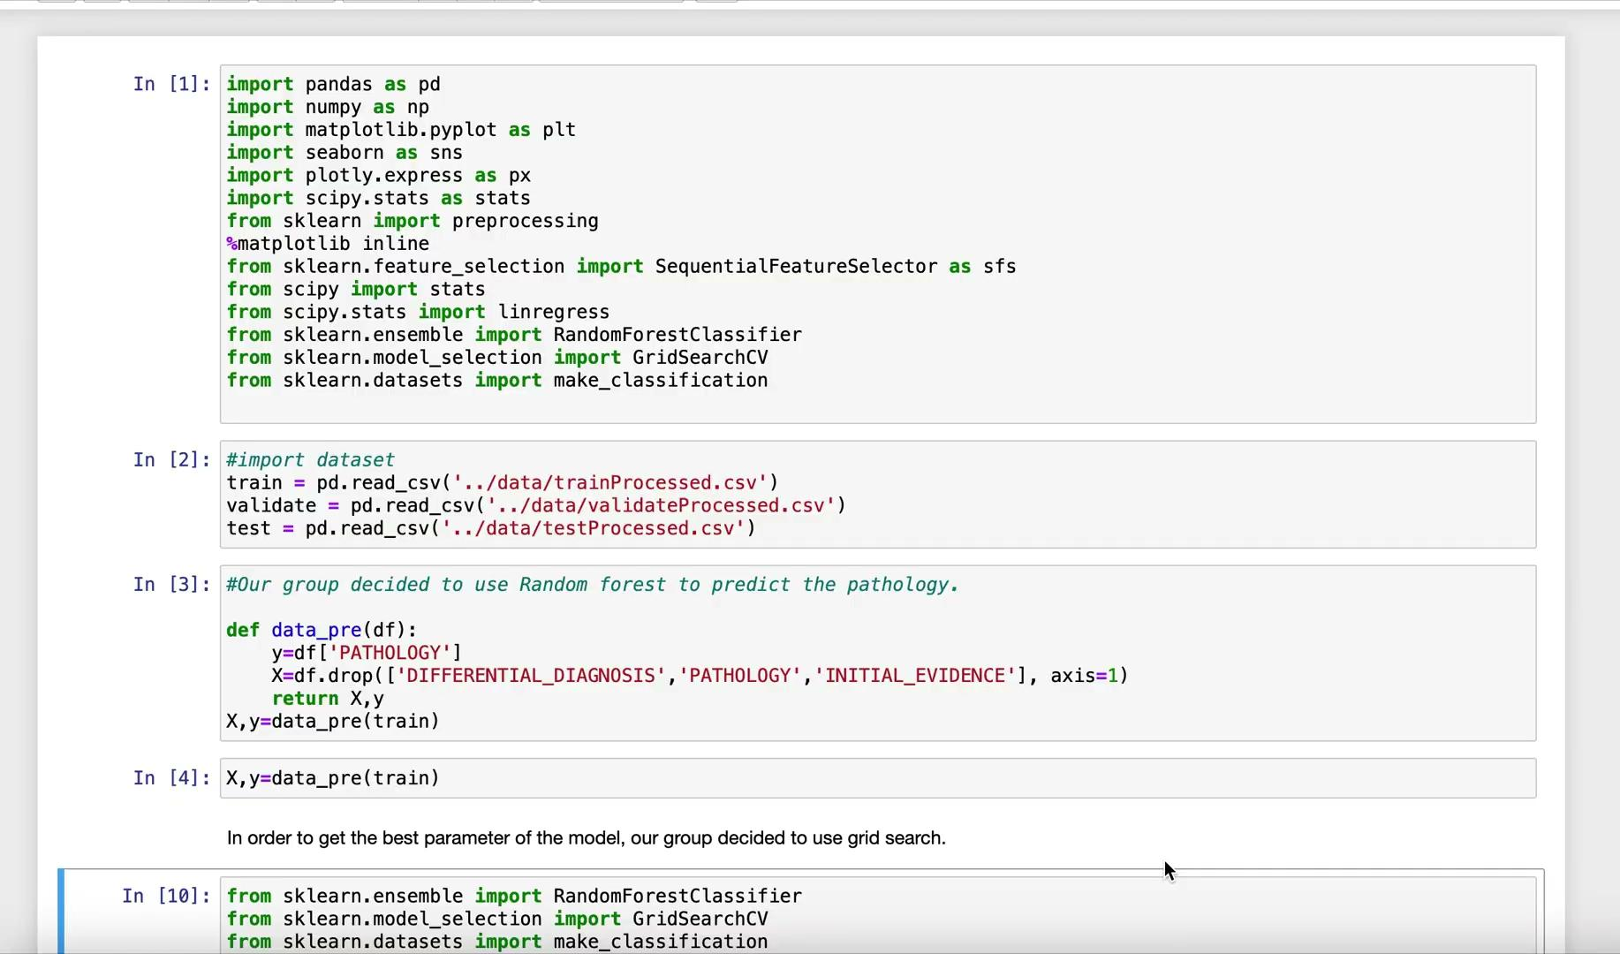
Demo - Best Pathology Model
Random Forest

Slide 15
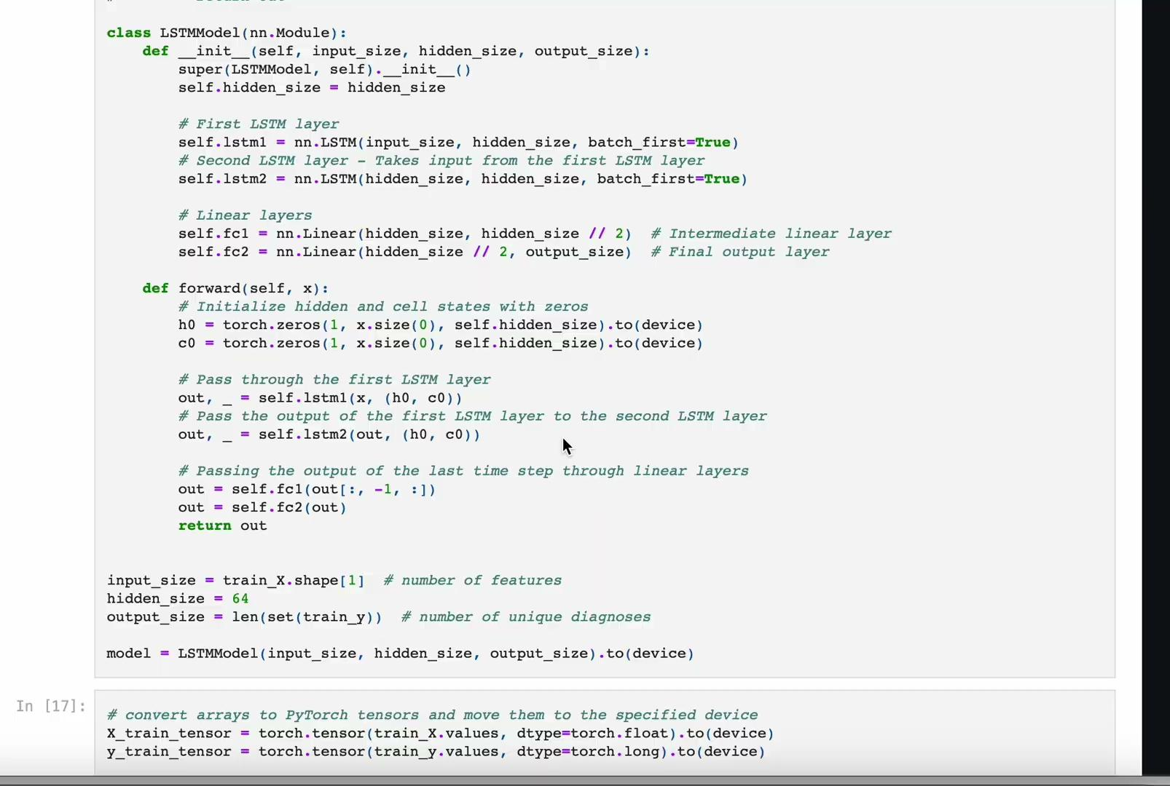
Demo - Best Differential Diagnosis Model
LSTM

Slide 16
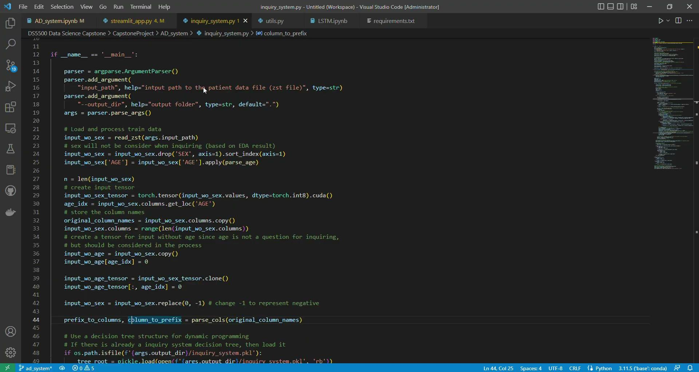
Demo - Inquiry System

Slide 17

Demo - Differential Diagnosis AD-System
Notes:
The app will ask questions to the users about their system and antecedent. All the user has to do is answering the question. So, we will skip this part. After answering all the questions, the record of each question is shown, and the differential diagnosis is generated.

Slide 18
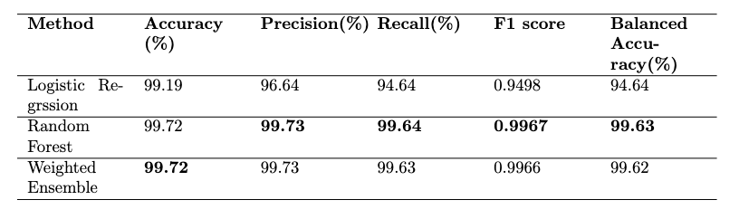
Result
Pathology Predictions
The best model in related papers reaches the Accuracy of 99.8%
Notes:
Here is the performance analysis of single pathology prediction. Among the three model we used, Random forest is the best model. In this part, we got similar performance as the result from paper by different approaches.

Slide 19
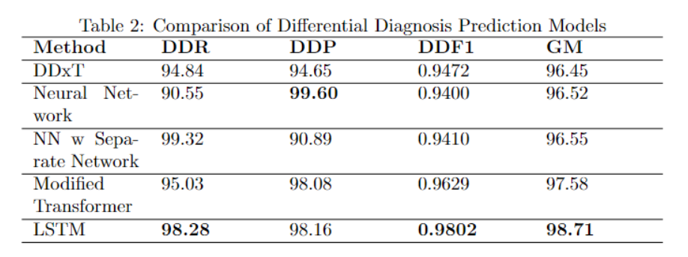
Result
Differential Diagnosis Predictions
Notes:
Here is the performance analysis of Differential Diagnosis. The first model DDxT is the model from the related paper. Following 4 are our models. Among them, the model with the highest performance is LSTM, which also surpasses DDxT model in all the metrics

Slide 20
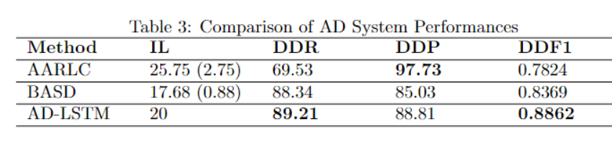
Result
AD Systems
Notes:
Here is the performance analysis of Differential Diagnosis after incorporating the inquiry system. That is, the performance of the AD system. As we know, to predict Differential Diagnosis with much less information that users provide is a much harder task. Therefore, the metrics are lower. The first 2 models are from related papers. As we can see our model AD-LSTM has the highest F1 score and has the best performance overall. With a question length of 20. That is 2 more questions than BASD. So it’s not too bad.

Slide 21
Postmortem
 | Familiarized ourselves with PyTorch, Tensorflow etc.
 | Apply and modify RNN, Transformer and Neural Network models.
 | Familiarized the functionalities of version control tools including GitHub and Overleaf.
 | Building an auto diagnosis system is still a difficult problem, a higher accuracy is still needed.
 | Future: Implement the AD System into larger and more complex datasets
Notes:
Postmortem. In this project, we familiarized ourselves with PyTorch, Tensorflow. and know how to Apply and modify RNN, Transformer and Neural Network models. Also, be Familiar with the functionalities of version control tools including GitHub and Overleaf. After this project, we found that building an auto diagnosis system is still a difficult problem, a higher accuracy is still needed. the Future improvement also can be Implementing the AD System into larger and more complex datasets

Slide 22
Deliverable
Github
01
https://github.com/zihanzhao1999/CapstoneProject.git
Paper
02
https://drive.google.com/file/d/1uRMR9rIt9vTURZagKhQRt8629X-Sa2hp/view?usp=sharing
Power Points
03
https://docs.google.com/presentation/d/1sMBtlt2VESs9EzfKXrOlRJAPcKSqK5LRQVoa0pLknb8/edit?usp=sharing
Notes:
We have pushed our code to github, and our paper and the slides are in the google drive. we may also put them in the github later.

Slide 23
Contribution
 | Ting Hsuan Chung
 | Data Preprocessing, EDA, Ensemble Model, Neural Network, Modified Transformer, Inquiry System, App, Paper Research, Writing
 | Jiaying Zheng
 | Data Preprocessing, EDA, RNN, LSTM, Logistic Regression, Inquiry System, APP, Paper Research, Writing
 | Zihan Zhao
 | Data Preprocessing, EDA, Random Forest, Neural Network, Inquiry System, App, Paper Research, Writing , Text processing
Notes:
Each of our team member contributes evenly. For the model accuracy enhancement part, each of us chose at least one model for pathology prediction and differential diagnosis prediction. For the auto-diagnosis system and application parts, we all contributed evenly.

Slide 24
Reference
Alam, M. M., Raff, E., Oates, T., & Matuszek, C. (2023). Ddxt: Deep generativetransformer models for differential diagnosis.Deep Generative Models
for Health Workshop NeurIPS 2023
Dong, Y., Cordonnier, J.-B., & Loukas, A. (2021). Attention is not all you need:Pure attention loses rank doubly exponentially with depth.
International Conference on Machine Learning, 2793–2803.
Eftimie, L. G., Glogojeanu, R. R., Tejaswee, A., Gheorghita, P., Stanciu, S. G.,Chirila, A., Stanciu, G. A., Paul, A., & Hristu, R. (2022). Differential diagnosis of thyroid nodule capsules using random forest guided selection of image features.Scientific Reports, 12(1), 21636.
Fansi Tchango, A., Goel, R., Wen, Z., Martel, J., & Ghosn, J. (2022). Ddxplus:A new dataset for automatic medical diagnosis.Advances in Neural Information Processing Systems,35, 31306–31318.
Haug, C. J., & Drazen, J. M. (2023). Artificial intelligence and machine learningin clinical medicine, 2023.New England Journal of Medicine, 388(13),1201–1208.
Huang, C., Chen, W., Liu, B., Yu, R., Chen, X., Tang, F., Liu, J., & Lu, W.(2022). Transformer-based deep-learning algorithm for discriminating demyelinating diseases of the central nervous system with neuroimaging. Frontiers in immunology,13, 897959.
Kaushik, S., Choudhury, A., Sheron, P. K., Dasgupta, N., Natarajan, S., Pickett,L. A., & Dutt, V. (2020). Ai in healthcare: Time-series forecasting usingstatistical, neural, and ensemble architectures.Frontiers in big data,3,4.
Luo, H., Li, S.-W., & Glass, J. (2021). Knowledge grounded conversational symptom detection with graph memory networks [arXiv preprint arXiv:2101.09773].
Men, L., Ilk, N., Tang, X., & Liu, Y. (2021). Multi-disease prediction using lstm recurrent neural networks.Expert Systems with Applications,177, 114905.
Miotto, R., Wang, F., Wang, S., Jiang, X., & Dudley, J. T. (2018). Deep learning for healthcare: Review, opportunities and challenges.Briefings in bioinformatics,19(6), 1236–1246.
Sunena Rose, M., & Sobhana, N. (2021). Automated diagnosis of diseases using integrated machine learning approaches.International Conference on Soft Computing and Pattern Recognition, 195–204.
Yuan, H., & Yu, S. (2024). Efficient symptom inquiring and diagnosis via adaptive alignment of reinforcement learning and classification.Artificial Intelligence in Medicine,148, 102748.

Slide 25
THANK YOU!

Slide 26
Q & A

